Slide 1

Optimising the Layout of 1000 Turbines
Markus Wagner
Optimisation and Logistics

Slide 2


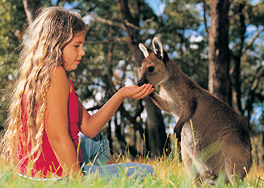

University: The University of Adelaide
Oldenburg to Adelaide: ~21h by plane
School of Computer Science
8 (associate) professors,
16 (senior) lecturers, and
ca. 21 research staff and ~50 PhD+MSc students
Topics: Computer Vision, Optimisation and Logistics, Distributed Computing, Software Engineering, …

Slide 3


Optimisation and Logistics
Leader: A/Prof. Frank Neumann
→ EC theory/applications
http://cs.adelaide.edu.au/~optlog/
Research Areas
Algorithmic Game Theory
Combinatorial Optimisation and Logistics
Foundations of Bio-Inspired Computing
Renewable Energy (IEEE TF, 2 SI, …)
Search-based Software Engineering
→ 50 publications since 2013, two best paper awards, …
Notes:
Involved in 19 publications (as of 25 Sept 2014)

Slide 4
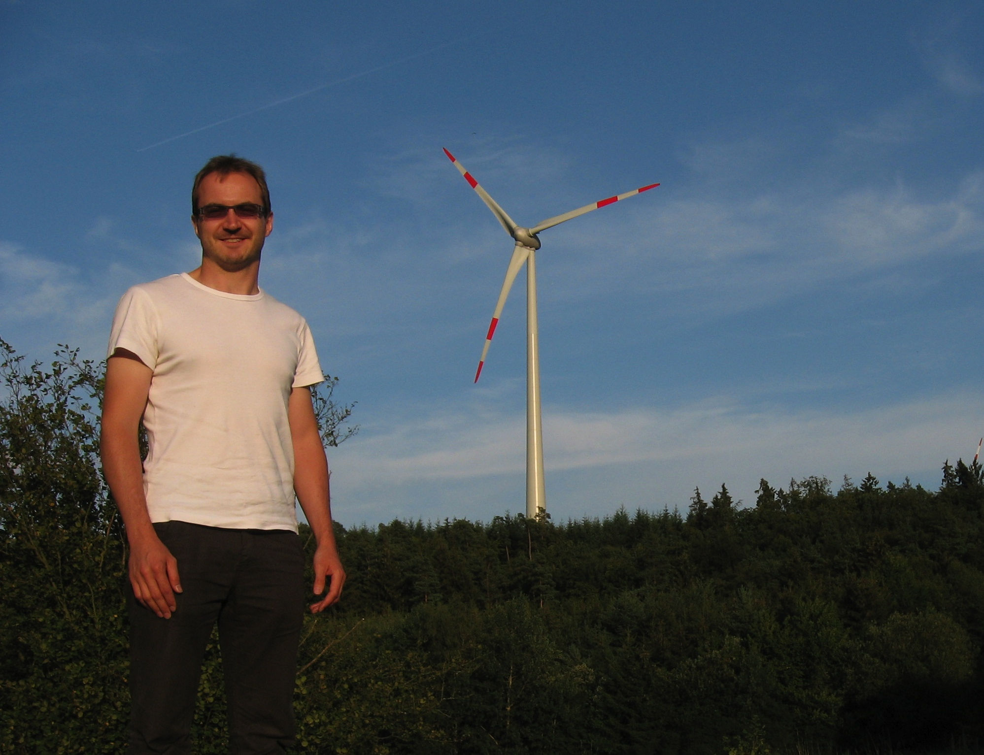

Slide 5
Renewable Energy
Has gained increasing interest
Is clean
Contributor to decrease CO2 emission
Is a huge market
Large developing effort
Has many challenging questions.

Slide 6
Wind Energy
Major player in renewable energy
In 2009, 39% of all new energy capacity installed in the EU was based on wind (2014 total: 117 GW)
Roughly 8800 wind turbines in Europe which helped to save 180 Mio tons of CO2 since the beginning of 2009.
Australia: 1.2 GW in 2007 → 3.0+ GW in 2013 (e.g. 420 MW farm opened in 2013 for $1 billion)
“Special Report on Renewable Energy Sources and Climate Change Mitigation” (2011)
Renewable energy could make up 77% in 2050
Wind energy could be responsible for 20%
Notes:
Since 2005 the cumulative installed capacity of wind energy within the EU has almost doubled (from 40 GW to 74 GW).

Slide 7
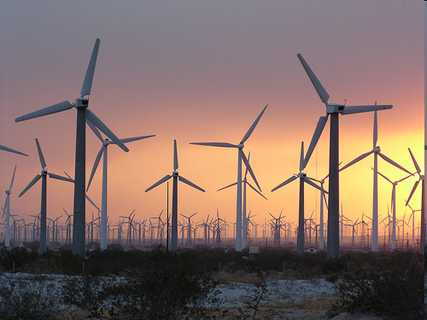
Source: Wind Power Ninja

Slide 8
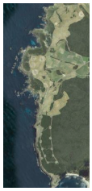
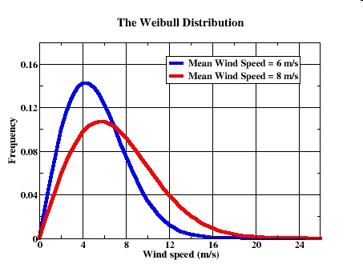
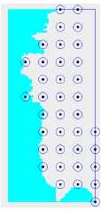
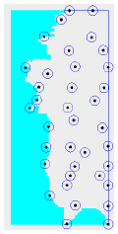
Example: Wind Turbine Placement
Joint work with Jareth Day (UoA), Frank Neumann (UoA), Kalyan Veeramachaneni (MIT), Una-May O'Reilly (MIT)
[EWEA, CEC, GECCO, Renewable Energy]
Woolnorth wind farm, TAS
Park wake model
wind distribution
turbine
positions
predicted energy
production
+5.2%

Slide 9
In a nutshell…
Experimental Studies
Use maximal spacing
Include mechanism to deal with boundary constraints
Improve results of Kusiak and Song
What results do we get for large wind farms?
Problem
Evaluation is very costly for large number of turbines
(single optimization: two weeks for 1000 turbines)

Slide 10
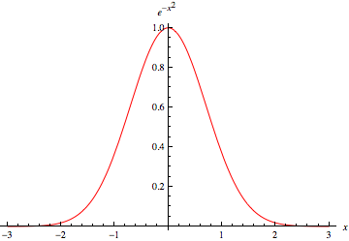

Algorithms - 1. Approach
Covariance Matrix Adaptation Evolution Strategy (CMA-ES)
X₁=0 Y₁=0 X₂=200 Y₂=350
f(s)
Sample 20x from multivariate normal distribution
update
update
f(s₁), f(s₂), …, f(s₂₀)
Result: pushed from 10-30 turbines to 1000

Slide 11
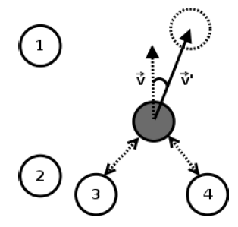
Algorithms - 2. Approach (problem-specific)
Turbine Distribution Algorithm
X₁=0 Y₁=0 X₂=200 Y₂=350
f(s)
Move 1 randomly chosen turbine
V
- direction resulting from k NN
V’
- Sampled normal distributed around V
- length is turbine specific (sampled normal distributed)

Slide 12
Algorithms - 2. Approach (problem-specific)
Turbine Distribution Algorithm
X₁=0 Y₁=0 X₂=200 Y₂=350
f(s)
Move 1 randomly chosen turbine
update
Dislocation length
(per turbine) used for exploitation/exploration
f(s₁)
Result: higher quality and speed

Slide 13
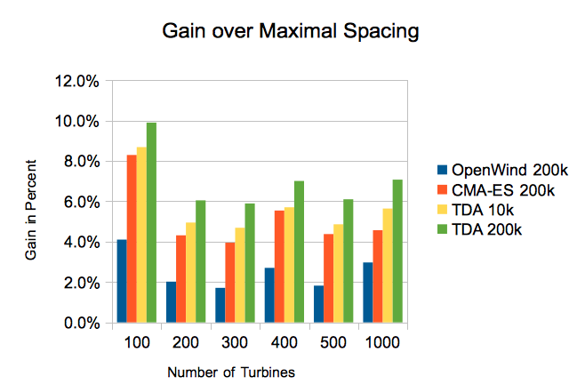
Industry Tool
1. Approach (general purpose)
2. Approach (problem specific)
Can translate into millions of additional EUR

Slide 14


Single-Objective Optimisation
output

Slide 15


Multi-Objective Optimisation
output
area

Slide 16
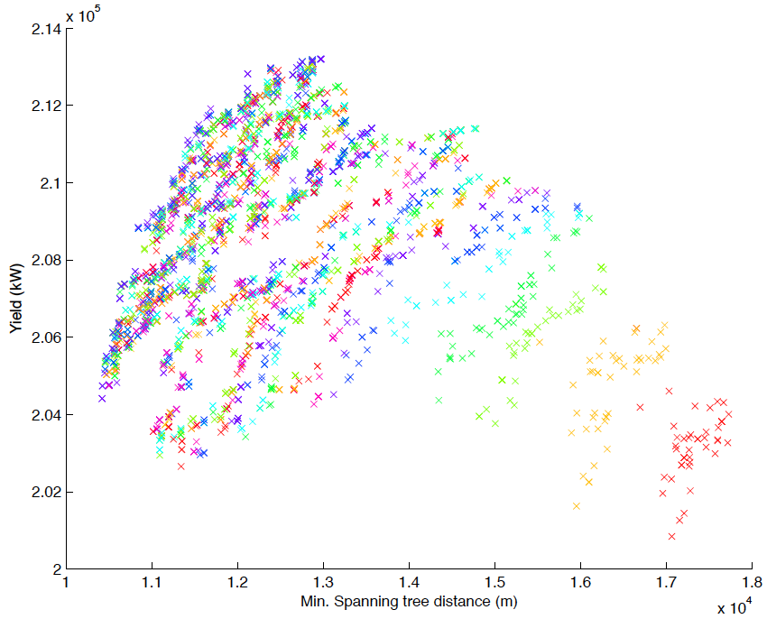
Progression

Slide 17
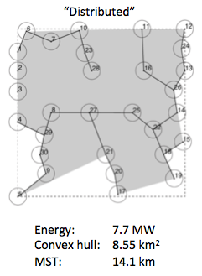
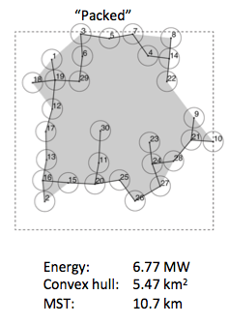
Progression

Slide 18
Take away
Renewable energy is an interesting field with challenging optimization problems
Problems are very complex
Evolutionary algorithms (our key technology) are well suited for tackling these problems
There is a lot of money in this field (grants, government support, industry funding)
Computer Science/Mathematics/Physics/… should play a key role

Slide 19
Take away
Future Work:
Improve simulator: mixed wind farms, more complex wake models, infeasible areas, …
More complex objectives (cable types, …)
Use contact with industry!
Our group website
http://cs.adelaide.edu.au/~optlog
http://cs.adelaide.edu.au/~markus
foundational and applied research
(e.g., many-objective optimisation, combinatorial)
Thank you!

