Slide 1
Introduction to Programming
My first red-eye removal
Notes:
BEFORE THE PRESENTATION:
Make sure that the mediasources are reachable – write it down on the whiteboard, if necessary (in case this gets figured out in the last minute)
NOTE: the outreach-accounts do not seem to have internet access. Consequently, the information on the last page (for a quick copy and paste) will not be available.

Slide 2
What most schools don’t teach
https://www.youtube.com/watch?v=nKIu9yen5nc
The hour of code
https://www.youtube.com/watch?v=FC5FbmsH4fw
“If 'coding' would be your superpower, what would you do?”

Slide 3
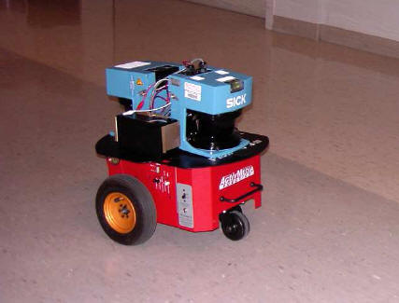
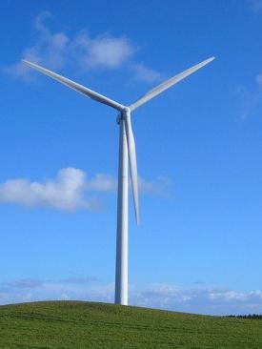
Computer Science
What else do we do in CS here at the University of Adelaide:
“Internet of Things”
And much more…

Slide 4
Computer Science
Computing has become pervasive, touching nearly every aspect of our lives.
A degree in computer science can open up opportunities for employment in the software development industry, and also in many areas including healthcare, business, engineering, medicine, graphics, utilities, and education.
Personally:
I have been to over 25 countries, have friends and colleagues in Italy, Norway, Germany, UK, China, Japan, USA, …
I have been active in CS since 2003, and it has been an awesome journey so far!

Slide 5
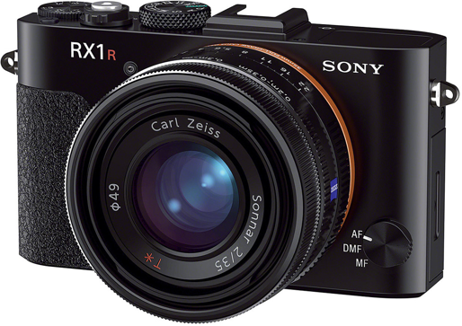
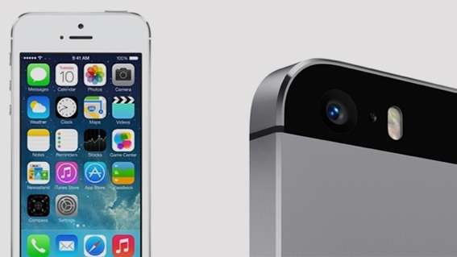
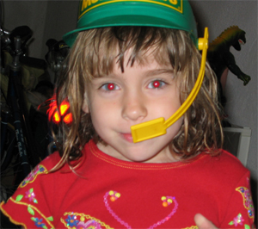
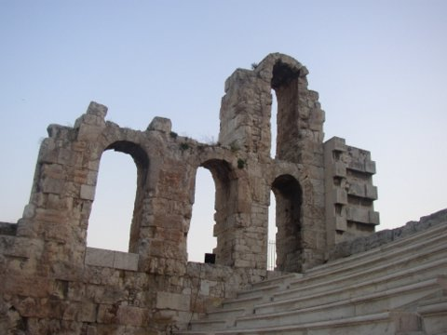
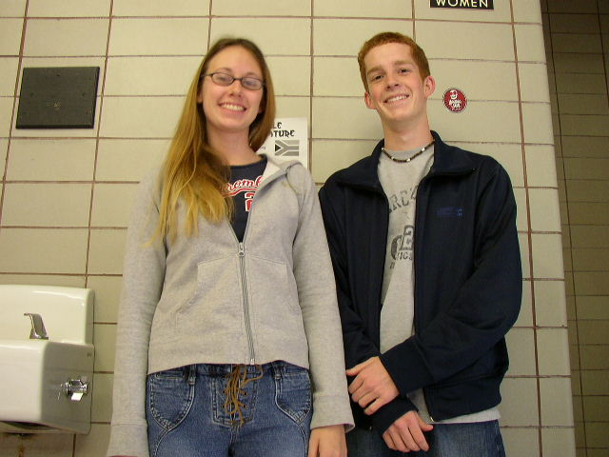

Slide 6
Goals
To understand the use of a matrix of pixels in representing a picture.
To understand how to change the colour of a pixel in an image.
Our tool
Jython Environment for Students http://code.google.com/p/mediacomp-jes/

Slide 7
What computers understand
Everything is 0’s and 1’s
Computers are exceedingly stupid
The only data they understand is 0’s and 1’s
They can only do the most simple things with those 0’s and 1’s
Move this value here
Add, multiply, subtract, divide these values
Compare these values, and if one is less than the other, go follow this step rather than that one.
Done fast enough, those simple things can be amazing.

Slide 8
Key Concept: Encodings
We can interpret the 0’s and 1’s in computer memory any way we want.
We can treat them as numbers.
We can encode information in those numbers
Even the notion that the computer understands numbers is an interpretation
We encode the voltages on wires as 0’s and 1’s, eight of these defining a byte
Which we can, in turn, interpret as a decimal number

Slide 9
We perceive light differently from how it actually is
Colour is continuous
Visible light is in the wavelengths between 370 and 730 nanometers
That’s 0.00000037 and 0.00000073 meters
But we perceive light with colour sensors that peak around 425 nm (blue), 550 nm (green), and 560 nm (red).
Our brain figures out which colour is which by figuring out how much of each kind of sensor is responding
Dogs have only two kinds of sensors
They do see colour. Just less colour.

Slide 10
Digitising pictures as bunches of little dots
We digitise pictures into lots of little dots
Enough dots and it looks like a continuous whole to our eye
Our eye has limited resolution
Each picture element is referred to as a pixel

Slide 11
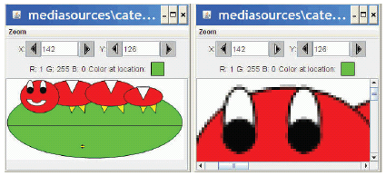
Pixels
Pixels are picture elements
Each pixel object (in JES) knows its colour and position
A picture is a matrix of pixels
>>> file = ‘/users/generic/mathsci/caterpillar.jpg’
>>> pict = makePicture(file)
>>> explore(pict)
When we zoom the picture to 500%, we can see individual pixels.

Slide 12
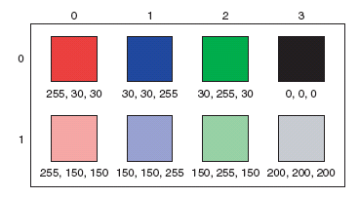
Encoding Colour
Each pixel encodes colour at that position in the picture
Each component colour (red, green, and blue) is encoded as a single byte
Colours go from (0,0,0) to (255,255,255)
If all three components are the same, the colour is in greyscale
(200,200,200) at (3,1)
(0,0,0) (at position (3,0) in example) is black
(255,255,255) is white
That’s 16,777,216 (2²⁴) possible colors!
[Note: this is only one possible encoding format amongst several]

Slide 13
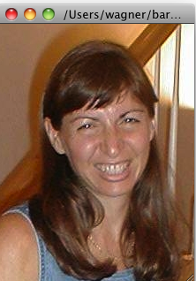
In JES: showing a picture
>>> file = pickAFile()
>>> print(file)
/users/generic/mathsci/barbara.jpg
>>> show(picture)
>>> print(picture)
Picture, filename /users/generic/mathsci/barbara.jpg height 294 width 222

Slide 14
Manipulating pixels
getPixel(picture,x,y) gets a single pixel.
getPixels(picture) gets all of them in an array.
>>> pixel=getPixel(picture,0,0)
>>> print(pixel)
Pixel, color=color r=168 g=131 b=105
>>> pixels=getPixels(picture)
>>> print(pixels[0])
Pixel, color=color r=168 g=131 b=105

Slide 15
What can we do with a pixel?
getRed, getGreen, and getBlue are functions that take a pixel as input and return a value between 0 and 255
setRed, setGreen, and setBlue are functions that take a pixel as input and a value between 0 and 255
Similarly for “colours” (a pixel has a location and a colour):
setColour, getColour, makeColour, …
Let us see this in an example…

Slide 16
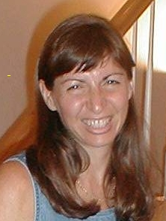
We can change pixels directly…
>>> file=‘/users/generic/mathsci/barbara.jpg‘ >>> pict=makePicture(file)
>>> show(pict)
>>> setColor(getPixel(pict,10,100),yellow)
>>> setColor(getPixel(pict,11,100),yellow)
>>> setColor(getPixel(pict,12,100),yellow)
>>> setColor(getPixel(pict,13,100),yellow)
>>> repaint(pict)
But that’s really dull and boring to change each pixel at a time… Isn’t there a better way?

Slide 17
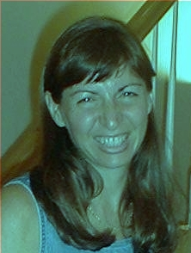
Use a loop! Our first picture recipe
def decreaseRed(picture):
for p in getPixels(picture):
value=getRed(p)
setRed(p,value*0.5)
Used like this:
>>> file=‘/users/generic/mathsci/barbara.jpg‘
>>> picture=makePicture(file)
>>> show(picture)
>>> decreaseRed(picture)
>>> repaint(picture)
Copy & paste from
http://tinyurl.com/unitech2015

Slide 18
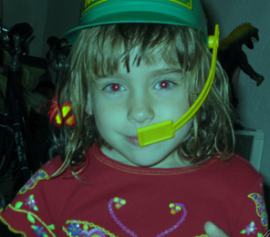
Our first picture recipe works for any picture
def decreaseRed(picture):
for p in getPixels(picture):
value=getRed(p)
setRed(p,value*0.5)
Used like this:
>>> file=‘/users/generic/mathsci/katie.jpg‘
>>> picture=makePicture(file)
>>> show(picture)
>>> decreaseRed(picture)
>>> repaint(picture)

Slide 19
How do you make an omelet?
Something to do with eggs…
What do you do with each of the eggs?
And then what do you do?
All useful recipes involve repetition
- Take four eggs and crack them….
- Beat the eggs until…
We need these repetition (“iteration”) constructs in computer algorithms, too!

Slide 20
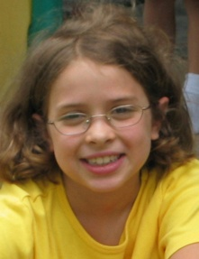
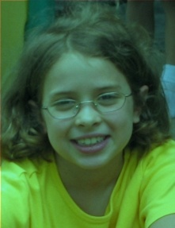
Decreasing the red in a picture
``
Recipe: To decrease the red
Ingredients: One picture, name it pict
Step 1: Get all the pixels of pict. For each pixel p in the set of pixels…
Step 2: Get the value of the red of pixel p, and set it to 50% of its original value

Slide 21
Use a for loop! Our first picture recipe
def decreaseRed(picture):
for p in getPixels(picture):
value = getRed(p)
setRed(p, value * 0.5)
The loop.
Note the indentation!

Slide 22
How for loops are written
def decreaseRed(picture):
for p in getPixels(picture):
value = getRed(p)
setRed(p, value * 0.5)
for is the name of the command
An index variable is used to hold each of the different values of a sequence
The word in
A function that generates a sequence
The index variable will be the name for one value in the sequence, each time through the loop (the fact that we use getPixels should suffice here)
A colon (“:”)
And a block (the indented lines of code)

Slide 23
What happens when a for loop is executed
The index variable is set to an item in the sequence
The block is executed
The variable is often used inside the block
Then execution loops to the for statement, where the index variable gets set to the next item in the sequence
Repeat until every value in the sequence was used.

Slide 24
Let’s walk that through slowly…
Here we take a picture object in as a parameter to the function and call it picture
def decreaseRed(picture):
for p in getPixels(picture):
originalRed = getRed(p)
setRed(p, originalRed * 0.5)
picture

Slide 25
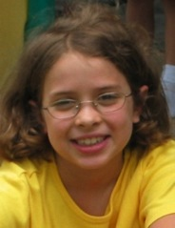
Now, get the pixels
def decreaseRed(picture):
for p in getPixels(picture):
originalRed = getRed(p)
setRed(p, originalRed * 0.5)
We get all the pixels from the picture, then make p be the name of each pixel one at a time
picture
getPixels()
Pixel, color r=135 g=131 b=105
Pixel, color r=133 g=114 b=46
Pixel, color r=134 g=114b=45
…
p

Slide 26
Now, get the red value from pixel p
def decreaseRed(picture):
for p in getPixels(picture):
originalRed = getRed(p)
setRed(p, originalRed * 0.5)
We get the red value of pixel p and name it originalRed
picture
getPixels()
Pixel, color r=135 g=131 b=105
Pixel, color r=133 g=114 b=46
Pixel, color r=134 g=114b=45
…
…
p
originalRed= 135

Slide 27
Now change the pixel
def decreaseRed(picture):
for p in getPixels(picture):
originalRed = getRed(p)
setRed(p, originalRed * 0.5)
Set the red value of pixel p to 0.5 (50%) of originalRed
picture
getPixels()
Pixel, color r=67 g=131 b=105
Pixel, color r=133 g=114 b=46
Pixel, color r=134 g=114b=45
…
p
originalRed = 135

Slide 28
Then move on to the next pixel
def decreaseRed(picture):
for p in getPixels(picture):
originalRed = getRed(p)
setRed(p, originalRed * 0.5)
Move on to the next pixel and name it p
picture
getPixels()
Pixel, color r=67 g=131 b=105
Pixel, color r=133 g=114 b=46
Pixel, color r=134 g=114b=45
…
p
originalRed = 135

Slide 29
Get its red value
Set originalRed to the red value at the new p, then change the red at that new pixel.
def decreaseRed(picture):
for p in getPixels(picture):
originalRed = getRed(p)
setRed(p, originalRed * 0.5)
picture
getPixels()
Pixel, color r=67 g=131 b=105
Pixel, color r=133 g=114 b=46
Pixel, color r=134 g=114b=45
…
p
originalRed = 133
p
p

Slide 30
And change this red value
def decreaseRed(picture):
for p in getPixels(picture):
originalRed = getRed(p)
setRed(p, originalRed * 0.5)
Change the red value at pixel p to 50% of value
picture
getPixels()
Pixel, color r=67 g=131 b=105
Pixel, color r=66 g=114 b=46
Pixel, color r=134 g=114b=45
…
p
value = 133
p
p

Slide 31
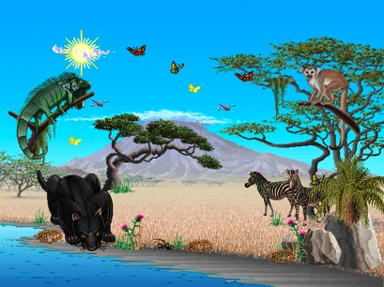
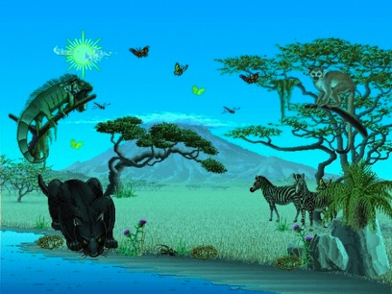
And eventually, we do all pixels
We go from this… to this!
Or from this… to this!
You can apply
this one filter
to many
different
pictures!

Slide 32
“Tracing/Stepping/Walking through” the program
What we just did is called “stepping” or “walking through” the program
You consider each step of the program, in the order that the computer would execute it
You consider what exactly would happen
You write down what values each variable (name) has at each point.
It’s one of the most important debugging skills you can have.
And everyone has to do a lot of debugging, especially at first.

Slide 33
Read it as a Recipe
def decreaseRed(picture):
for p in getPixels(picture):
originalRed = getRed(p)
setRed(p, originalRed * 0.5)
Recipe: To decrease the red
Ingredients: One picture, name it pict
Step 1: Get all the pixels of pict. For each pixel p in the pixels…
Step 2: Get the value of the red of pixel p, and set it to 50% of its original value

Slide 34
Introducing the function range
Range returns a sequence between its first two inputs, possibly using a third input as the increment
>>> print range(1,4)
[1, 2, 3]
>>> print range(-1,3)
[-1, 0, 1, 2]
>>> print range(1,10,2)
[1, 3, 5, 7, 9]
>>> print range(3)
[0,1,2]
Notice:
End value is never included.
range(0,10) ends at 9.
If you leave out a start value, it’s assumed to be zero.

Slide 35
We can use range to generate index numbers
We’ll do this by working the range from 0 to the height-1, and 0 to the width-1.
Using the range function will make it easy to start from 0 and stop before the end value.
But we’ll need more than one loop.
Each for loop can only change one variable, and we need two for indexing a matrix

Slide 36
Working the pixels by number
To use range, we’ll have to use nested loops
One to walk the width, the other to walk the height
Be sure to watch your blocks (i.e., indentation) carefully!
def increaseRed2(picture):
for x in range(0,getWidth(picture)):
for y in range(0,getHeight(picture)):
p = getPixel(picture,x,y)
value = getRed(p)
setRed(p,value*1.1)

Slide 37
What’s going on here?
def increaseRed2(picture):
for x in range(0,getWidth(picture)):
for y in range(0,getHeight(picture)):
p = getPixel(picture,x,y)
value = getRed(p)
setRed(p,value*1.1)
The first time through the first loop, x starts at 0.
We’ll be processing the first column of pixels in the picture.

Slide 38
Now, the inner loop
def increaseRed2(picture):
for x in range(0,getWidth(picture)):
for y in range(0,getHeight(picture)):
p = getPixel(picture,x,y)
value = getRed(p)
setRed(p,value*1.1)
Next, we set y to 0. We’re now going to process each of the pixels in the first column.

Slide 39
Process a pixel
def increaseRed2(picture):
for x in range(0,getWidth(picture)):
for y in range(0,getHeight(picture)):
p = getPixel(picture,x,y)
value = getRed(p)
setRed(p,value*1.1)
With x = 0 and y = 0, we get the upperleftmost pixel and increase its red by 10%

Slide 40
Next pixel
def increaseRed2(picture):
for x in range(0,getWidth(picture)):
for y in range(0,getHeight(picture)):
p = getPixel(picture,x,y)
value = getRed(p)
setRed(p,value*1.1)
Next we set y to 1 (next value in the sequence range(0,getHeight(picture))

Slide 41
Process pixel (0,1)
def increaseRed2(picture):
for x in range(0,getWidth(picture)):
for y in range(0,getHeight(picture)):
p = getPixel(picture,x,y)
value = getRed(p)
setRed(p,value*1.1)
x is still 0, and now y is 1, so increase the red for pixel (0,1)
We continue along this way, with y taking on every value from 0 to the height of the picture (minus 1).

Slide 42
Finally, next column
def increaseRed2(picture):
for x in range(0,getWidth(picture)):
for y in range(0,getHeight(picture)):
p = getPixel(picture,x,y)
value = getRed(p)
setRed(p,value*1.1)
Now that we’ re done with the loop for y, we get back to the FOR loop for x. x takes on the value 1, and we go back to the y loop to process all the pixels in the column x=1.

Slide 43
There are many ways…
def decreaseRed(picture):
for p in getPixels(picture):
originalRed = getRed(p)
setRed(p, originalRed * 0.5)
Similarly, instead of using “getPixels” we can use the “range” function: (remember: pictures are matrices of pixels)
def decreaseRed2(picture):
for x in range(0,getWidth(picture)):
for y in range(0,getHeight(picture)):
p = getPixel(picture,x,y)
originalRed= getRed(p)
setRed(p, originalRed*0.5)

Slide 44
Removing “Red Eyes”
When the flash of the camera catches the eye just right (especially with light colored eyes), we get bounce back from the back of the retina.
This results in “red eyes”
We can replace the “red” with a color of our choosing.
First, we figure out where the eyes are (x,y) using the JES MediaTools (hint: pickAFile and then makePicture)
jenny.jpg

Slide 45
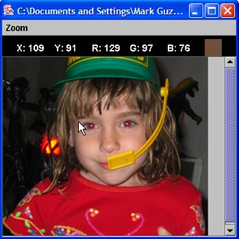
Removing Red Eye
def removeRedEye(picture,startX,startY,endX,endY,replacementcolor):
red = makeColor(255,0,0)
for x in range(startX,endX):
for y in range(startY,endY):
currentPixel = getPixel(picture,x,y)
if (distance(red,getColor(currentPixel)) < 165):
setColor(currentPixel,replacementcolor)
Why use a range? Because we don’t want to replace her red dress!
What we’re doing here:
Within the rectangle of pixels (startX,startY) to (endX, endY)
Find pixels close to red, then replace them with a new color

Slide 46
Distance between colors?
Sometimes you need to, e.g., when deciding if something is a “close enough” match
How do we measure distance?
Pretend it is the Cartesian coordinate system
Distance between two points:
Distance between two colors:
Fortunately, the distance function is already implemented (see previous slide)!

Slide 47
What would happen if we just did getPixels() here?
QUESTION: Why not process all pixels the same to remove redeye?
ANSWER: Just go back a couple of slides ;)
We would remove the red in her dress
The whole picture would go red
The whole picture would go black
We would probably miss her eyes

Slide 48
“Fixing” it: Changing red to black
removeRedEye(jenny, 109, 91, 202, 107, makeColor(0,0,0))
Jenny’s eyes are actually not black—could fix that
Eye are also not mono-color
A better function would handle gradations of red and replace with gradations of the right eye color

Slide 49
Replacing colors using IF
We don’t have to do one-to-one changes or replacements of color
We can use if to decide if we want to make a change.
We could look for a range of colors, or one specific color.
We could use an operation (like multiplication) to set the new color, or we can set it to a specific value.
It all depends on the effect that we want – and on how much you have developed your superpower! ☺

Slide 50
That’s all folks!
For more information visit http://cs.adelaide.edu.au/
More about Computing and computing Careers, from IEEE
http://www.trycomputing.org/discover
NCSS challenge - learn python online at the National CS School, $20 registration, several weeks in August
https://groklearning.com/challenge/
These slides are available online: http://cs.adelaide.edu.au/~markus/teaching/outreach.html

